Slide 1

Lecture 07 Exercise 7: Mailbox Sharing
P₁, P₂, and P₃ share mailbox A
P₁, sends; P₂ and P₃ receive
Who gets the message?
Allow a link to be associated with at most two processes
Allow only one process at a time to execute a receive operation
Allow the system to select arbitrarily the receiver. Sender is notified who the receiver was.

Slide 2

COMP 7500/7506 Advanced Operating Systems
Examples of IPC Systems:
POSIX Shared Memory
Dr. Xiao Qin
Auburn University http://www.eng.auburn.edu/~xqin
xqin@auburn.edu
Notes:
2019 Spring:
Continue from Lec07b Slide 12 (Ex. 7).

Slide 3
Examples of IPC Systems
POSIX
Mach
The IPC system in the Mach OS
Shared Memory in POSIX Systems
Unix
Ordinary Pipes (see also Project 2) in Unix
Notes:
Overview

Slide 4
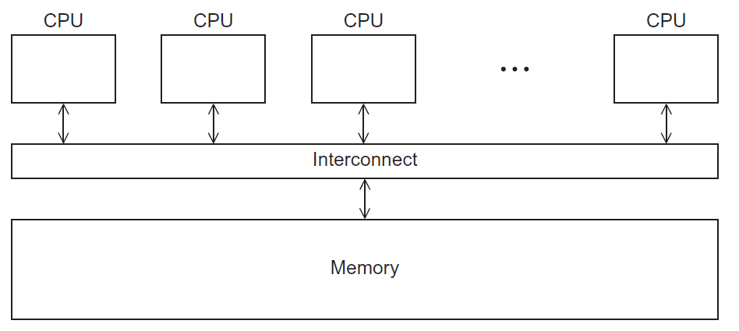
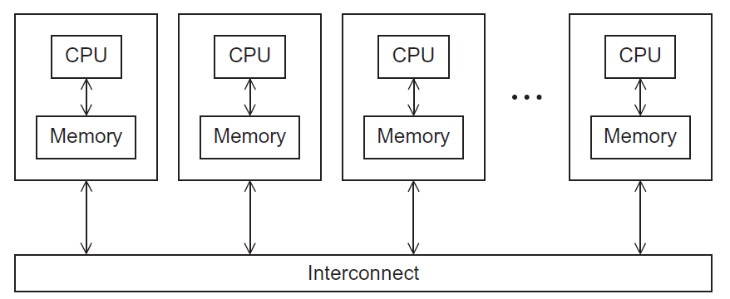
What is the POSIX Shared Memory?
API: To allow processes to communicate information by sharing a region of memory.
Notes:
Regardless of computer architecture design: SMP, MPP.
posix_ipc is a Python module (written in C) that permits creation and manipulation of POSIX inter-process semaphores, shared memory and message queues on platforms supporting the POSIX Realtime Extensions a.k.a. POSIX 1003.1b-1993. This includes nearly all Unices and Windows + Cygwin 1.7.
POSIX shared memory is supported since Linux 2.4 and glibc 2.2.
Current Version: 4.15. Jan. 28, 2018
Reference: https://www.kernel.org/

Slide 5
Persistence
POSIX shared memory objects have kernel persistence.
An shm object exists until
all processes have unmapped the object and
the object has been deleted
The system is shut down.
OR
Notes:
Reference: http://man7.org/linux/man-pages/man7/shm_overview.7.html

Slide 6
Exercise 1: Accessing POSIX Shared Memory Objects
What security feature should be built in shm?
Shared memory objects are created in a virtual file system, mounted under /dev/shm
In Linux, access control lists (ACLs) are used to control the permissions of objects in the virtual filesystem.
Notes:
Since kernel 2.6.19,
Reference: http://man7.org/linux/man-pages/man7/shm_overview.7.html

Slide 9
Exercise 2: Can you design four basic POSIX shared memory operations?
Create a new shm object: shm_open()
Close the shm object: close()
Map the shared memory object into the virtual address: mmap()
Unmap the shared memory object: munmap()
Set the size of the shared memory object: ftruncate()
Remove a shared memory object name: shm_unlink()
Notes:
Please propose 4 out of 6 operations.

Slide 10
Exercise 3: Given the following four operations, what is the correct sequence of these operations for producers and consumers?
shm_open()
mmap()
shm_unlink()
ftruncate()
sprintf() /* write a shared memory object */
printf() /* read from the shared memory */
Producer: open->set size->map->write
Consumer: open->map->read->unlink

Slide 11
Exercise 4: Can you design two security-related operations for the POSIX shared memory?
To change the ownership of a shared memory object: fchown()
To change the permissions of a shared memory object: fchmod()
Notes:
The link may be unidirectional, but is usually bi-directional

Slide 12
IPC POSIX Producer
Exercise 5: Can you explain the mmap() function (e.g., input parameters)? Which two items are linked together?
Notes:
Reference: http://man7.org/linux/man-pages/man2/mmap.2.html
mmap() creates a new mapping in the virtual address space of thecalling process.The starting address for the new mapping isspecified inaddr.Thelengthargument specifies the length of themapping (which must be greater than 0).Ifaddris NULL, then the kernel chooses the address at which tocreate the mapping; this is the most portable method of creating anew mapping.Ifaddris not NULL, then the kernel takes it as a hintabout where to place the mapping; on Linux, the mapping will becreated at a nearby page boundary.The address of the new mapping isreturned as the result of the call.
ptr refers to memory resource in the process, fd is the shm object.

Slide 13
IPC POSIX Consumer

Slide 16

Review Exercises (Plickers)
What does POSIX mean?
What is the IPC mechanism in POSIX systems?
Notes:
Cont. ch3.ppt, slide 44 Synchronization

